Slide 1
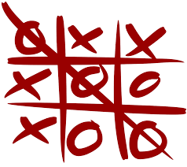
TIC-TAC-TOE
PRESENTATION BY
BHUTHKURI SUCHARITHA

Slide 2
CONTENTS
INTRODUCTION
WORKING
USES
ADVANTAGES AND DISADVANTAGES
FUTURE SCOPE

Slide 3
INTRODUCTION
Tic-tac-toe, also called noughts(/cricles) and crosses or X's and O's(/0's(/zeroes)) is a game for two people that only requires pencil and paper, although you can also use a board with tokens.Each player takes turns drawing a cross or a circle in a square (or placing tokens of different shapes or colors) The winner is the one who manages to place three equal pieces in a row, either vertically, horizontally or diagonally.

Slide 4
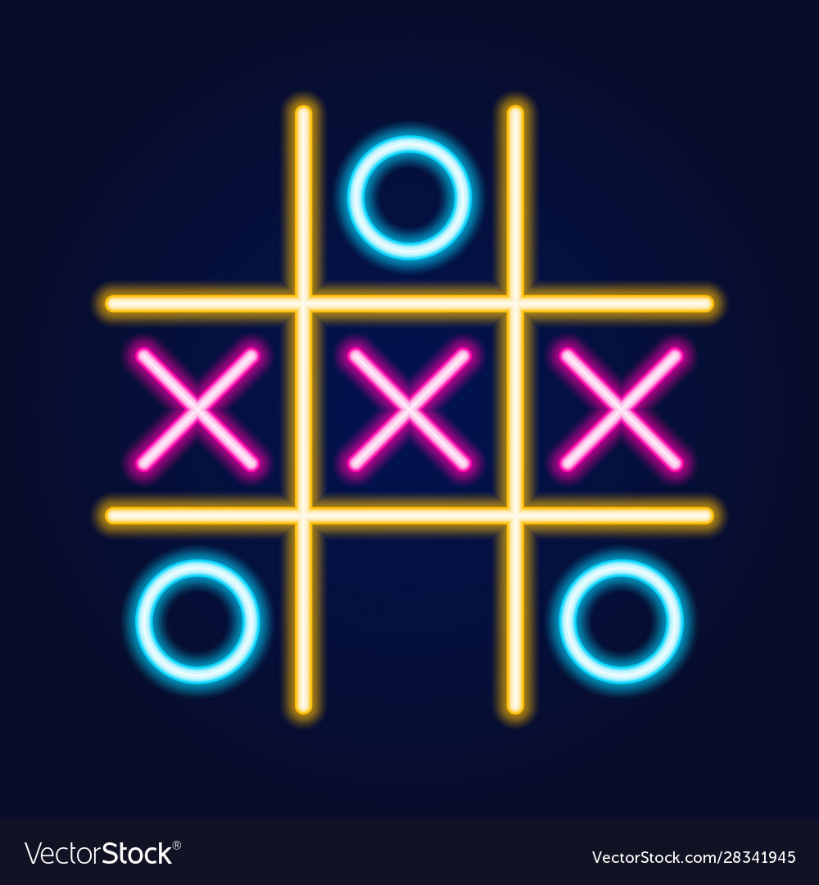
WORKING
If you’re the first player to go, put an X in any corner. So long as your opponent doesn’t put the first O in the center, it’s a solved win every single time. If they do play their first O in the center, place your second X in the opposite corner of your first X to establish an end-game.

Slide 5
USES
tic-tac-toe is often played by young children who may not have discovered the optimal strategy. Because of the simplicity of tic-tac-toe, it is often used as a pedagogical tool for teaching the concepts of good sportsmanship and the branch of artificial intelligence that deals with the searching of game trees. Playing tic tac toe requires children to think critically and use problem-solving skills to strategize and win the game. Encourages teamwork and cooperation

Slide 6
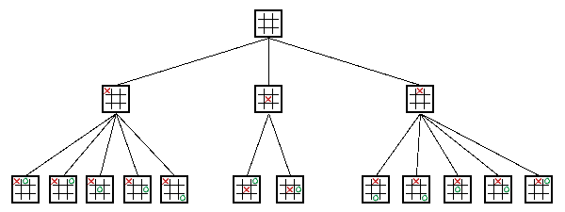
ADVANTAGES
Teaches strategy skills.
Develops logical thinking.
Improves the ability to concentrate and focus.
Teaches good sportsmanship.
Sets the foundation for learning more complex games.
Spurs on the development of fine motor skills and coordination.

Slide 7
DISADVANTAGES
It can get boring knowing that you are going to win every single time.
The game usually takes less than a minute to play.
You usually need paper and a pencil/pen to play.
. When you know how to win, the game isn’t very challenging.
If you’re new to the game, you could be taken advantage of by players who know the game’s winning strategies.

Slide 8
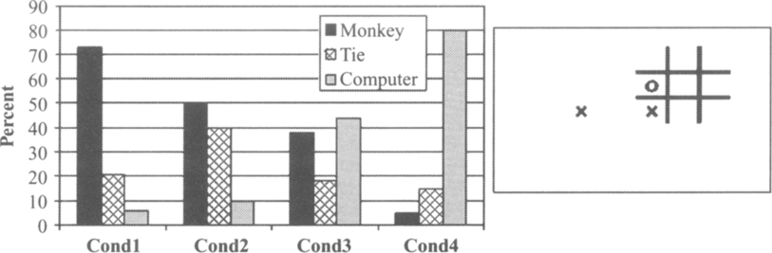
FUTURE SCOPE
The objectives are to create an entertaining game that teaches strategy and can be played online with friends.
The methodology uses a 3x3 board where players take turns entering numbers 1-9 to place X or O symbols in that position.
If a symbol makes a horizontal, vertical, or diagonal line it wins.

Slide 9
THANK
YOU

